Slide 1
The Python ARM Radar Toolkit (Py-ART)
The Latest and Greatest with Py-ART
Max Grover, Zach Sherman, Scott Collis – Argonne National Laboratory
ARM Open Science Team

Slide 2
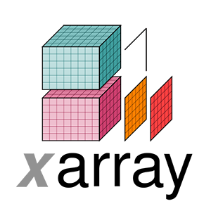



A Decade of Open Radar Science with the Python ARM Radar Toolkit (Py-ART)!
Initially created by Scott Collis and Jonathan Helmus (2013), funded by ARM, built to work with weather radar data
Over 340 citations of the package (peer-reviewed publications), 1000 monthly users
>600,000 package downloads
Recent development with array integration, moving to a standard IO library maintained by the broader community
research radars
corrections
retrievals
gridding
graph (viz)
pointers to other libraries
NEXRAD network
~13 other radar formats
pyart.Radar()

Slide 3
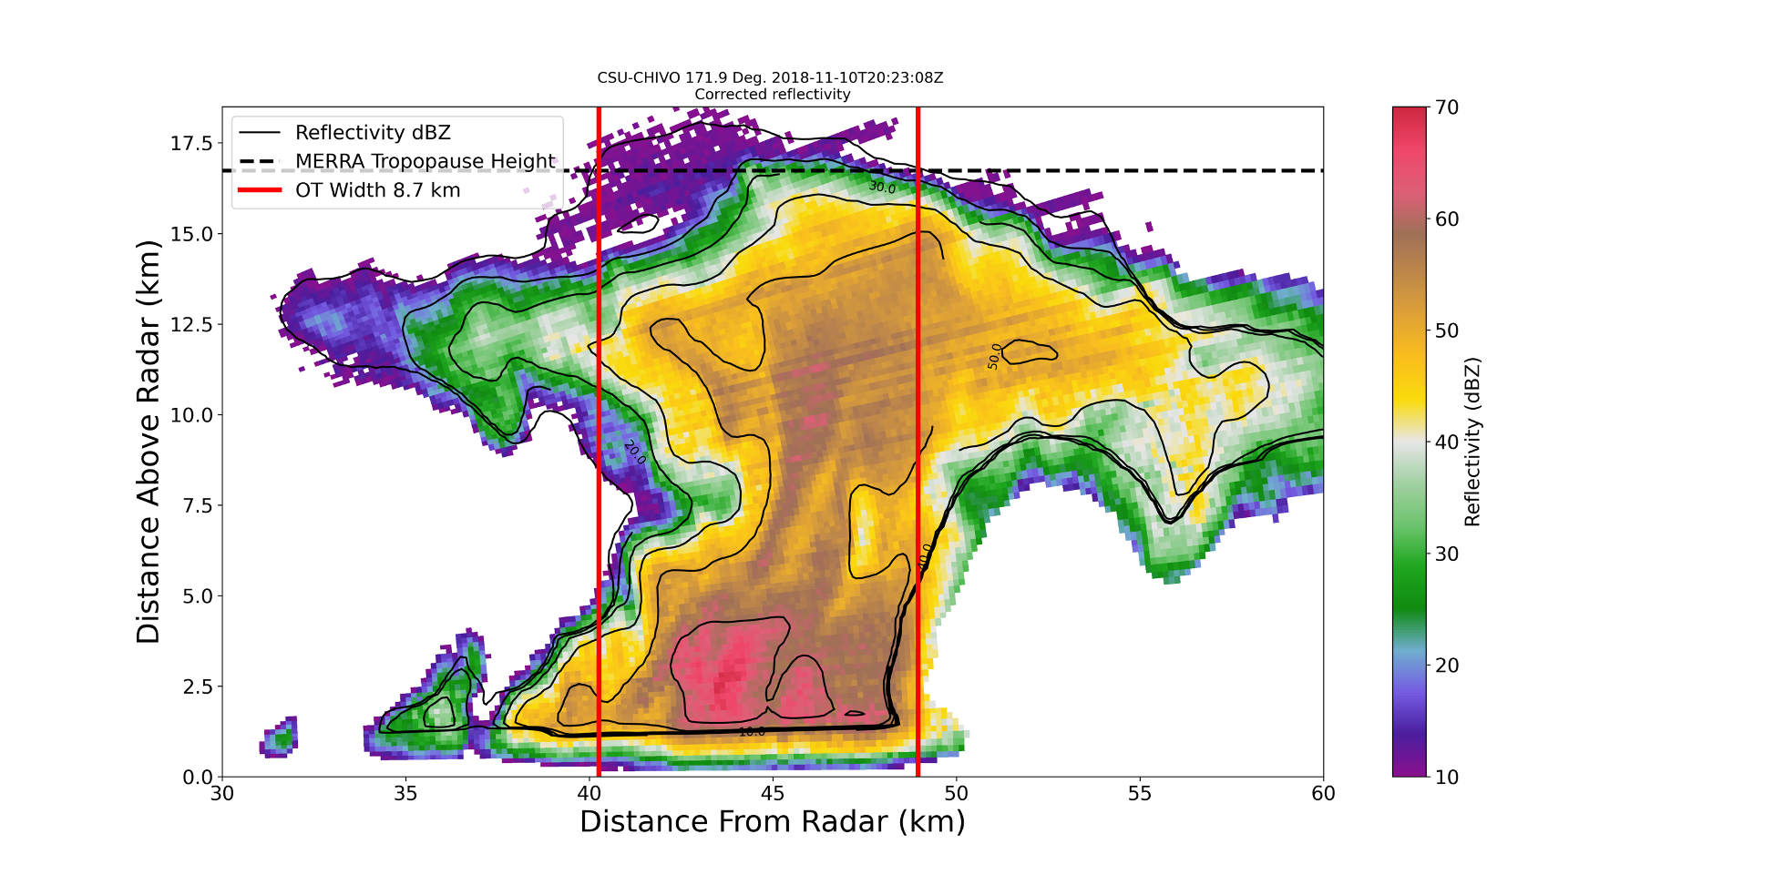
An Overshooting Top: Deep Convection in Argentina

Slide 4
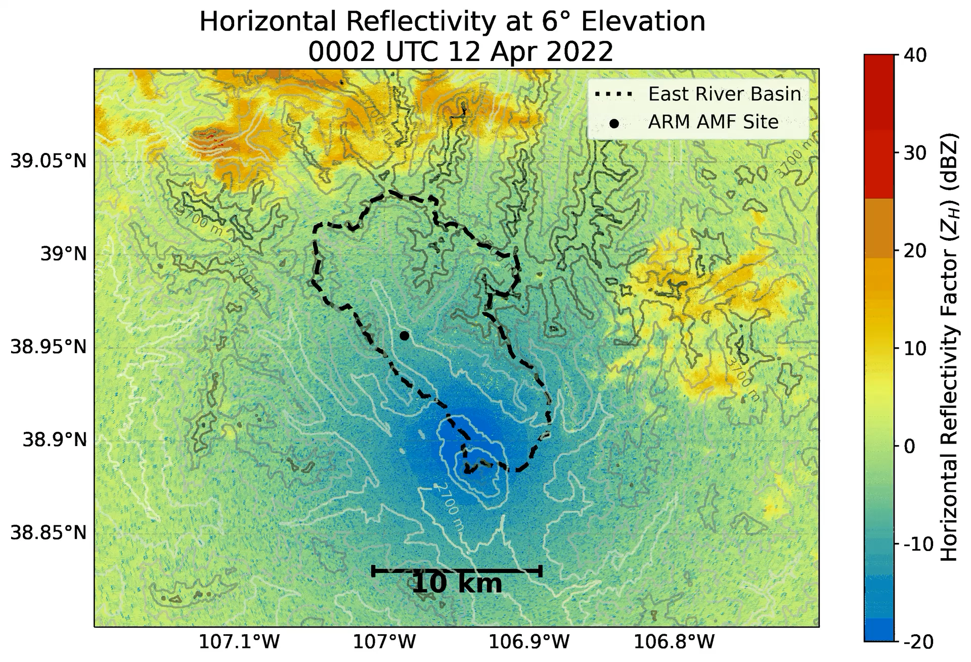
Snow in the Rockies: A SAIL Perspective

Slide 5
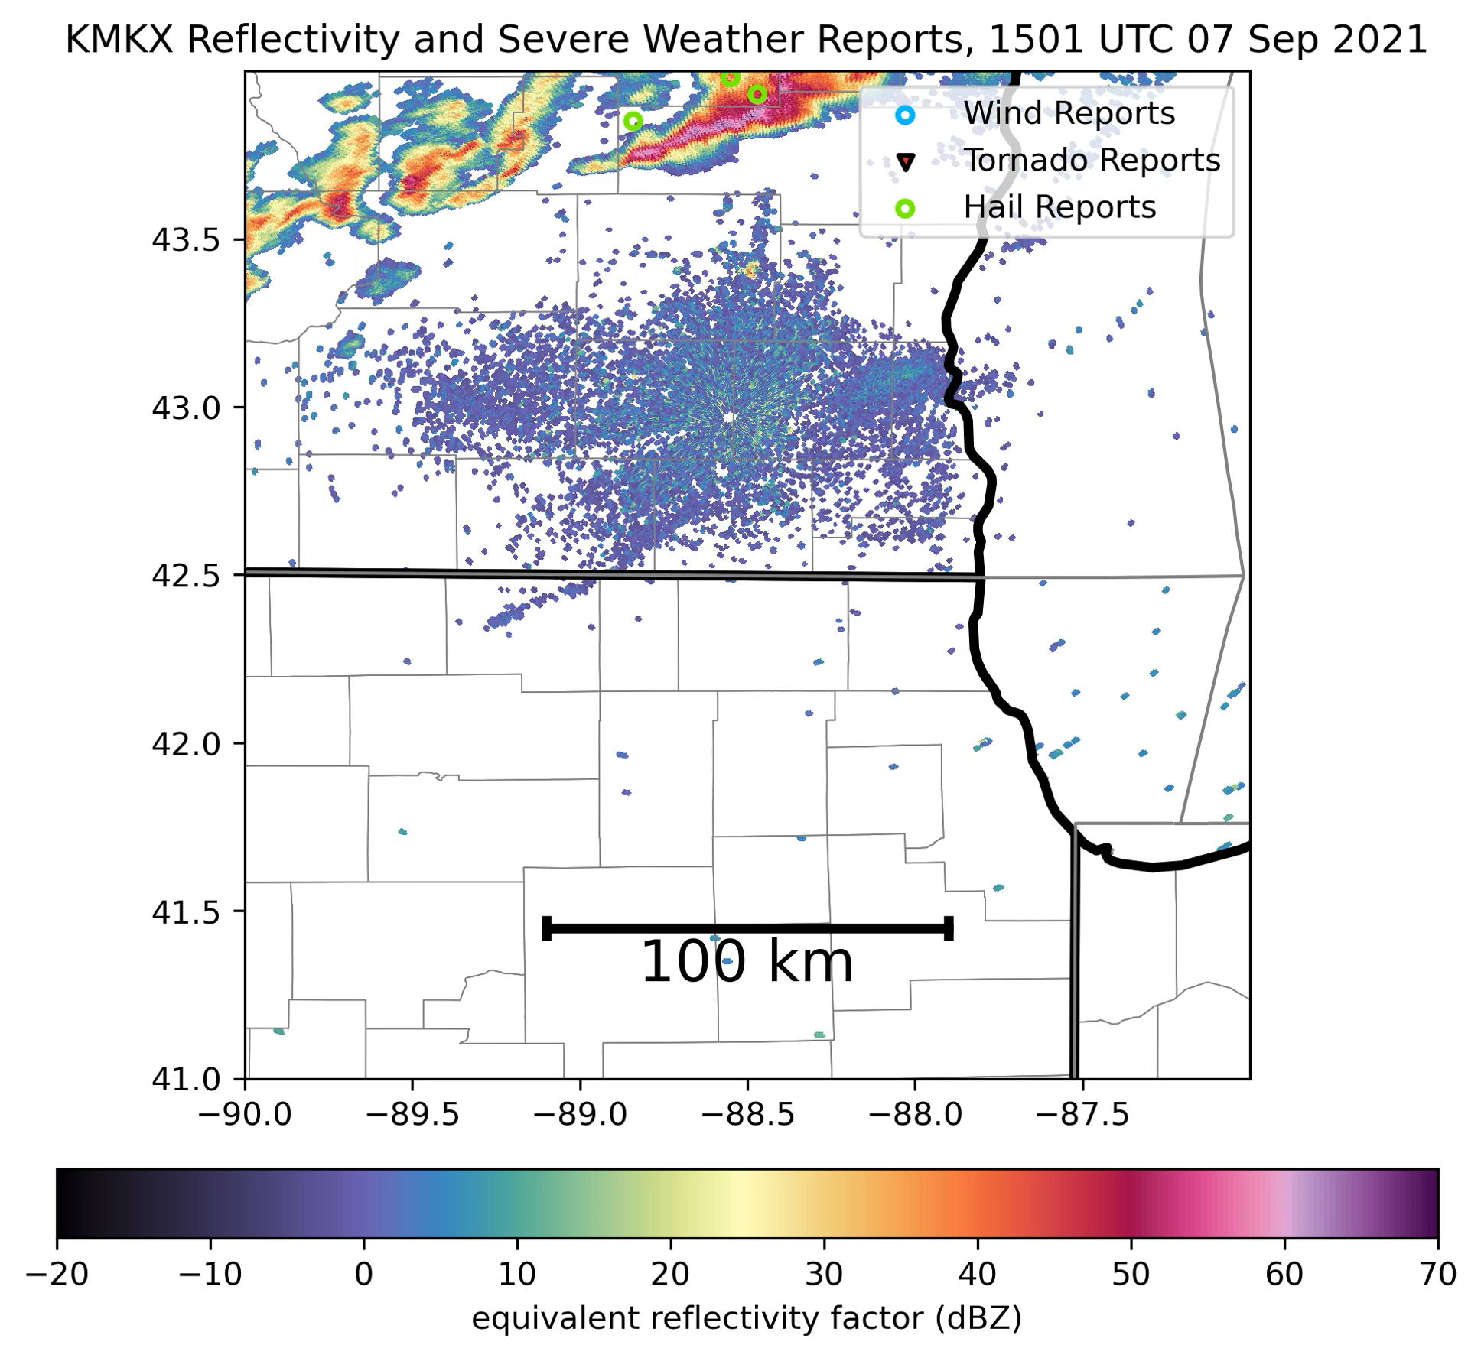
Tracking Severe Storms in the Midwest

Slide 6
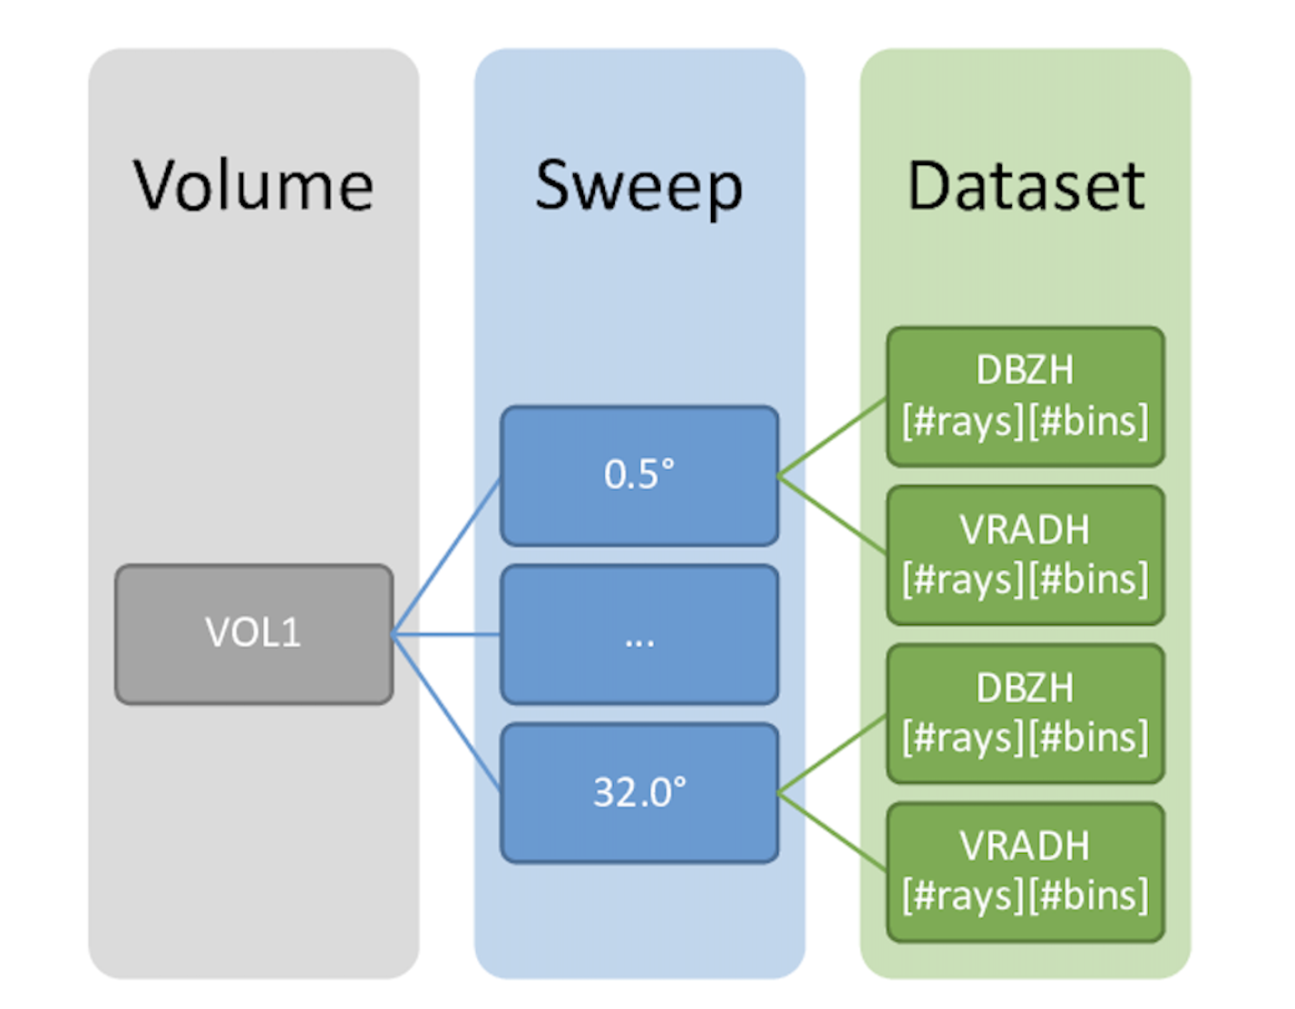
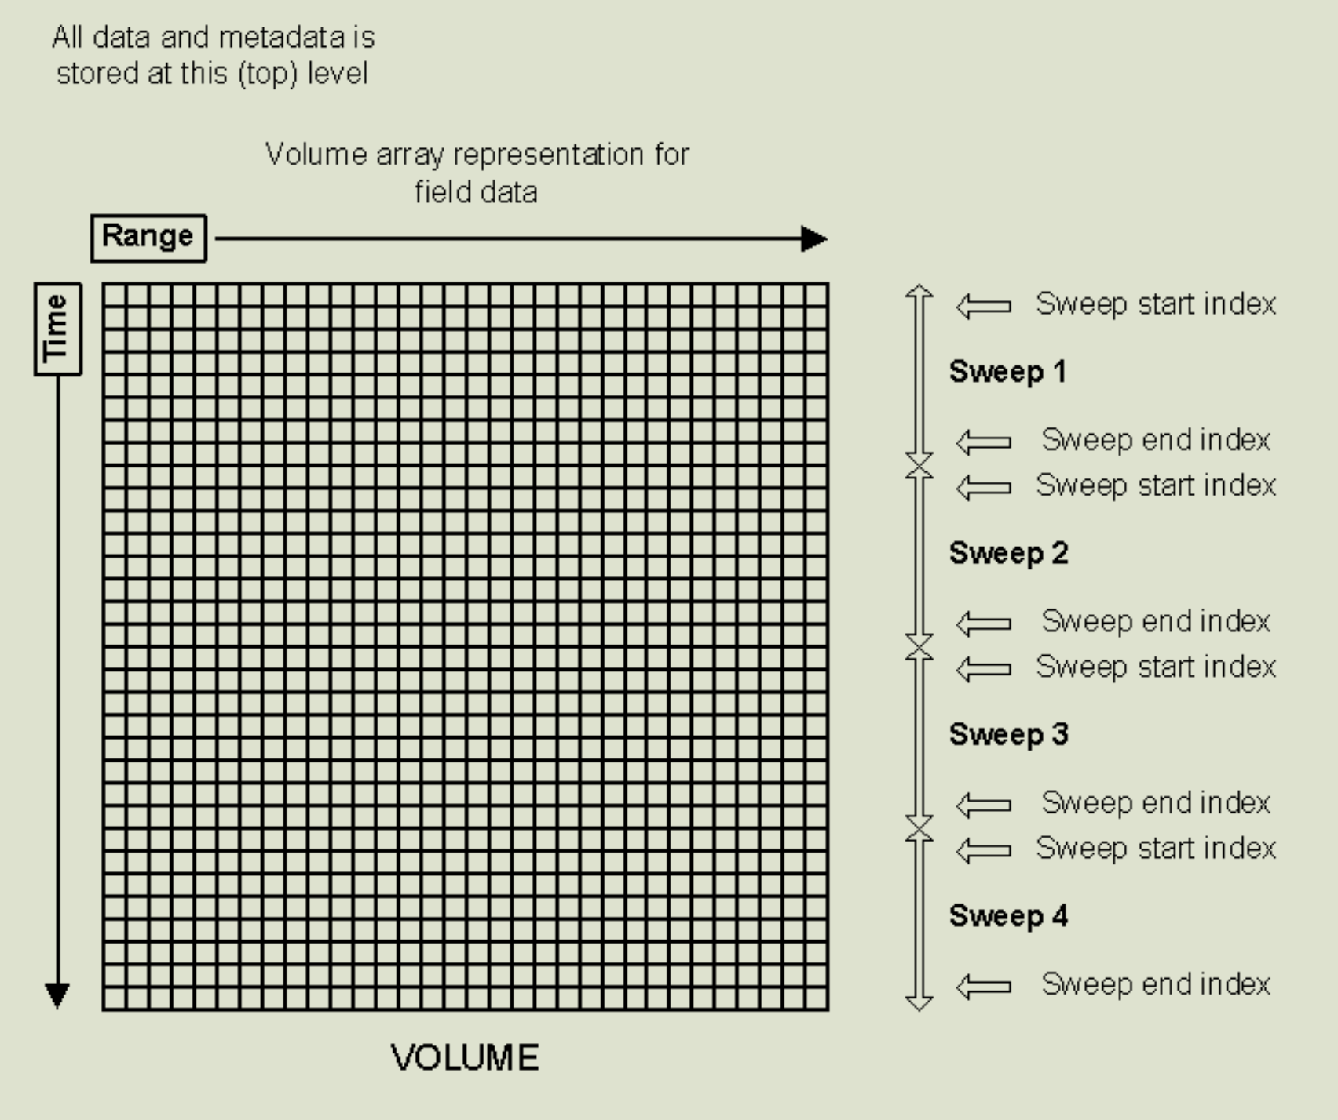
Next in the Roadmap: Supporting FM-301/Cfradial2
cfradial1
cfradial1

Slide 7
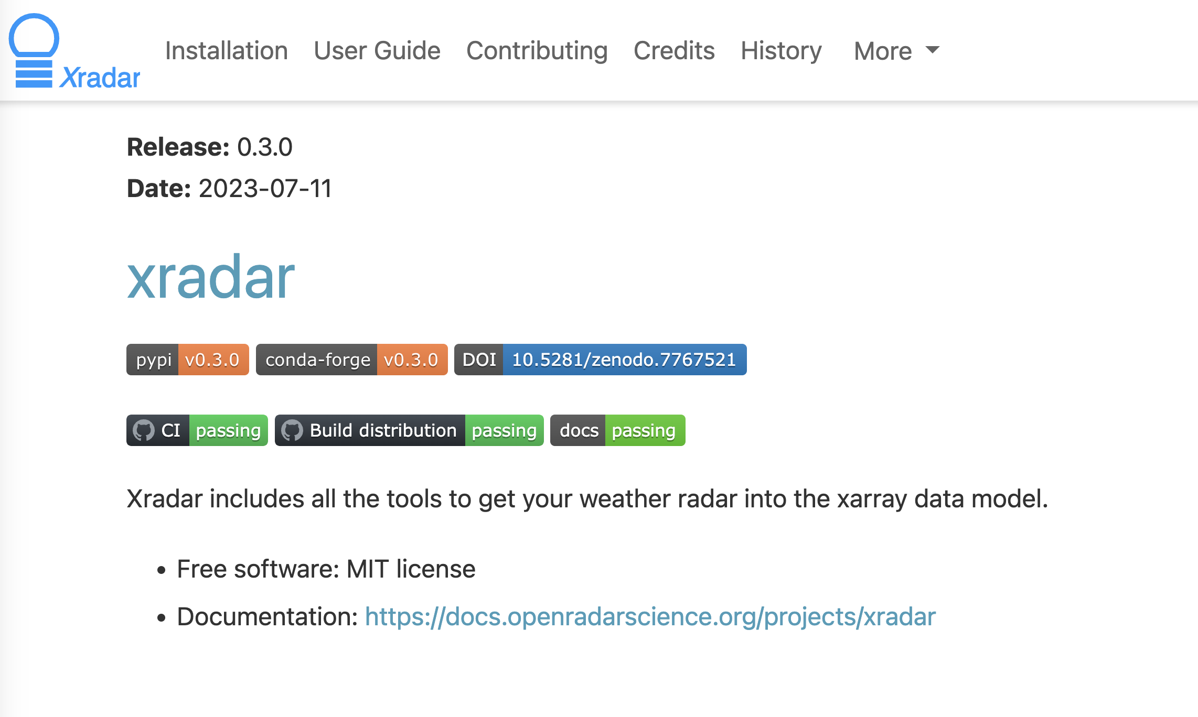
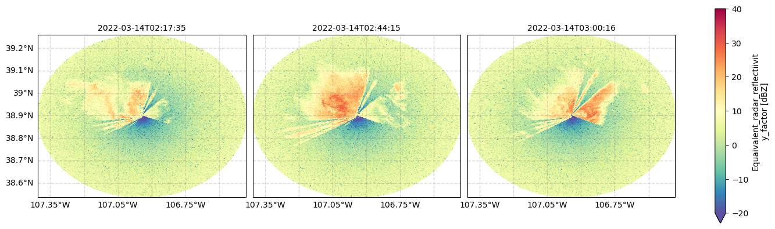
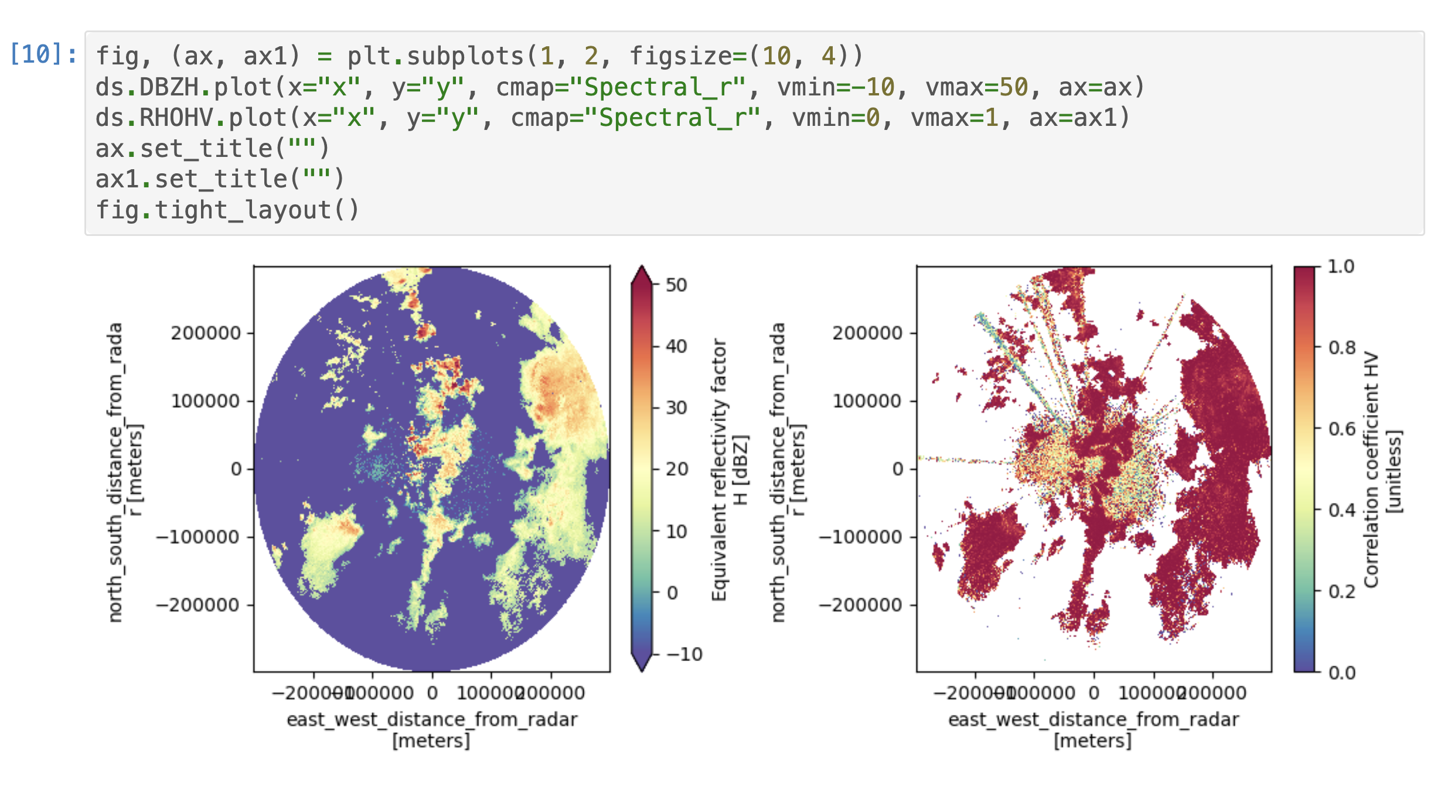
Xradar as the Core IO Library

Slide 8
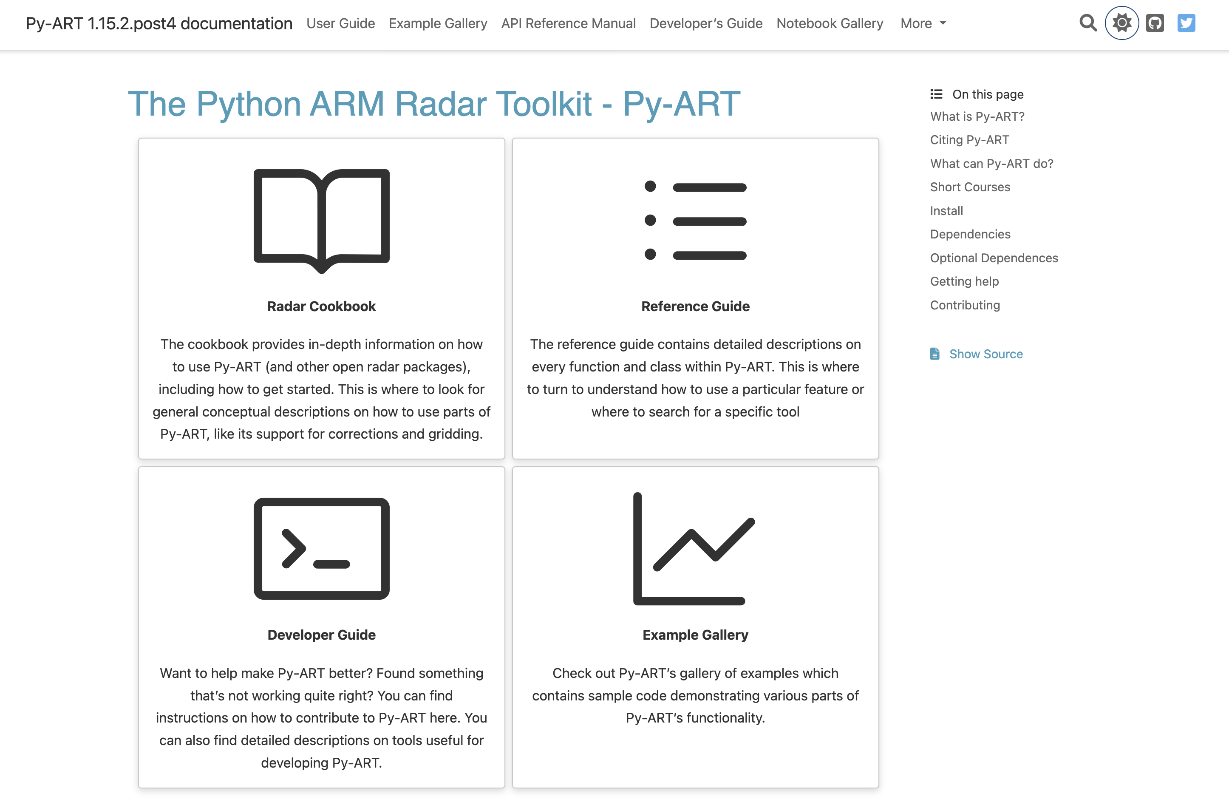
Updated Documentation

Slide 9
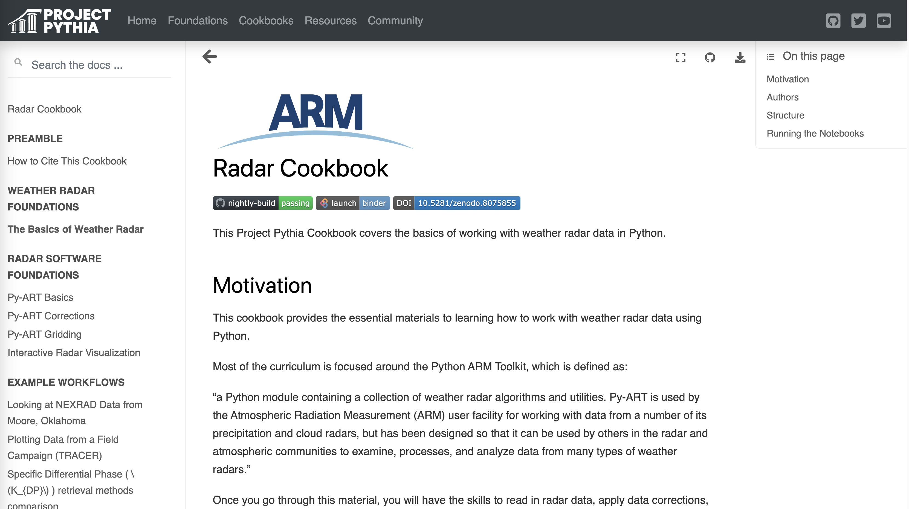
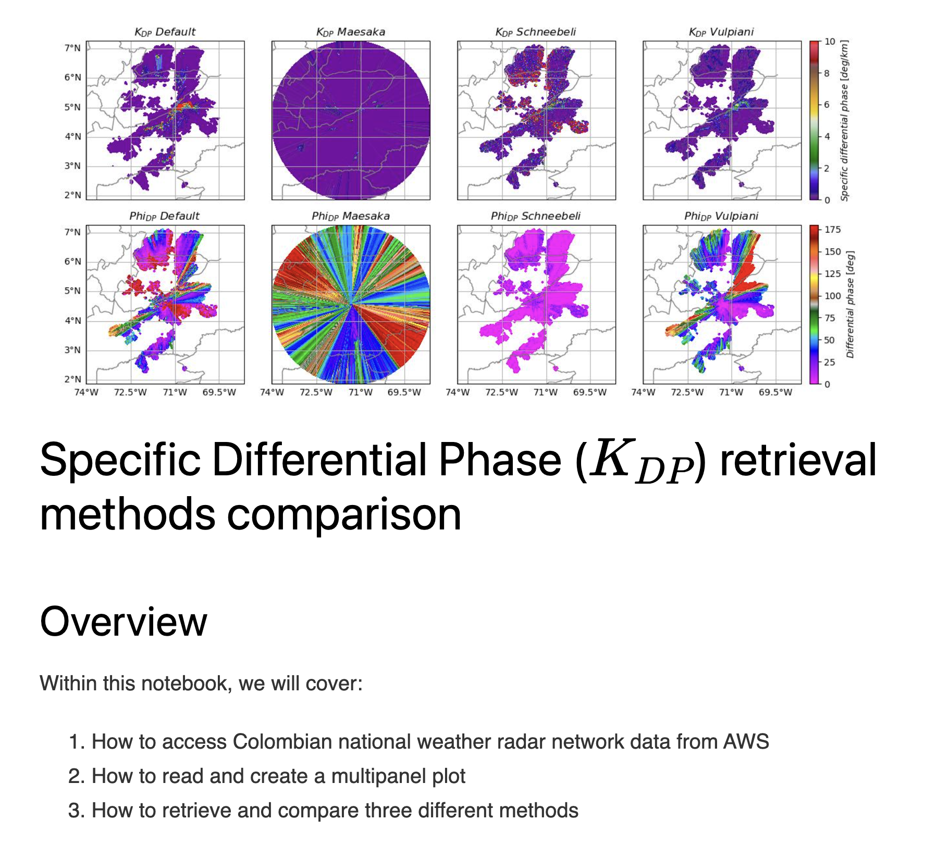
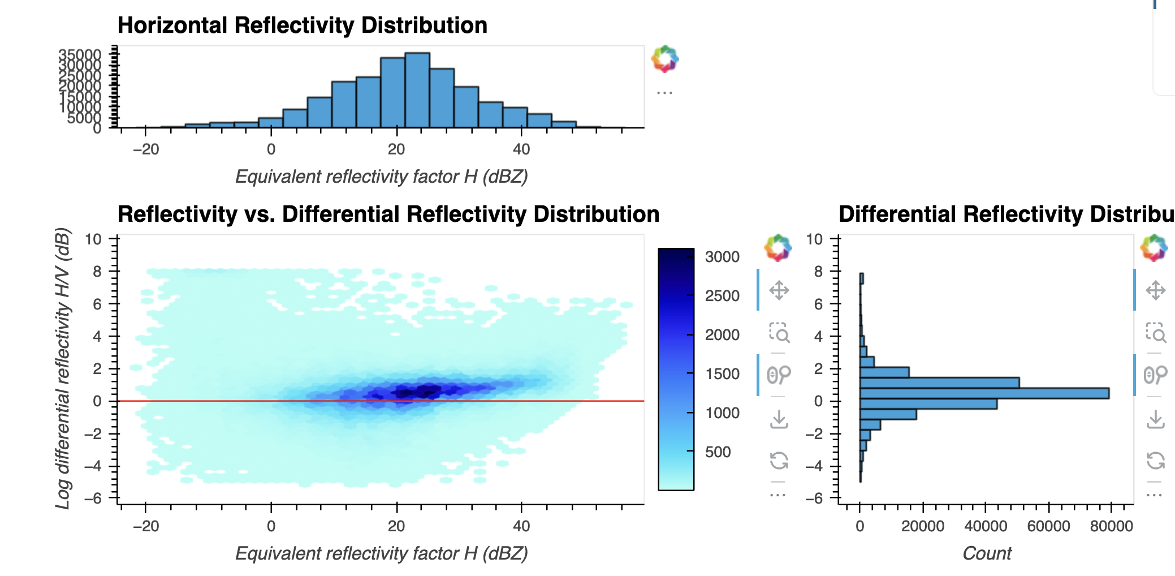
Radar Cookbooks: Educating the Open Radar Community

